Slide 1
Stock Market Prediction System
Under the guidance of
Dr. Mrs. Himangi Pande
Group Member Details
Harshali Bedmutha(B150028507)
Ria Garg(B150028525)
Ritika Jain(B150028535)

Slide 2
Contents
Problem Statement
Motivation
Objectives
Introduction
Literature Survey
Limitations of existing system
Scope
Methodology
System Architecture
UML Diagrams
Hardware and Software Requirements
Outcomes
References

Slide 3
Introduction
Stock market prediction is the act of trying to determine the future value of a company stock or other financial instrument traded on a financial exchange.
The successful prediction of a stock's future price could yield significant profit.
In recent years many machine learnig algorithms are being explored for accurate predictions of stock.
Some of these include CNN, ANN, LSTM, SVM etc.
This project aims at developing one such system to predict stock values based on historical data.

Slide 4
Problem Statement: Stock market prediction system using CNN Sliding Window Model and SVM with PSO
Abstract:
Prediction of stock market price is one of the most important issues in finance.
Many researchers have been given their idea how to forecast the market price in order to make gain using different techniques, such as technical analysis, statistical analysis, with different methods.
We aim at developing a hybrid system for stock market price prediction using Convolutional Neural Network(CNN) and Support Vector Machine with Particle Swarm Optimization

Slide 5
Motivation
Prediction of stock market price is one of the most important issues in finance.
With a successful model for stock prediction, we can gain insight about market behavior over time, spotting trends that would otherwise not have been noticed.
With the increasingly computational power of the computer, machine learning will be an eﬃcient method to solve this problem.
We can try to improve the accuracy of prediction by modifying the existing systems.

Slide 6
Objectives
To develop a system for accurately predicting stock price using Convolutional Neural Network Architecture(CNN) and Support Vector Machine(SVM)
To develop a Sliding Window based approach for better prediction
To determine the best values for pool length, no. of filters, no of hidden layer while construction of the CNN model.
To determine appropriate parameters for SVM using Particle Swarm Optimization(PSO).
To achieve higher efficiency in stock prediction.

Slide 7
Literature Survey
Sr. no | Title | Description | Results
1 | Sreelekshmy Selvin, Vinayakumar R, Gopalakrishnan E.A, Vijay Krishna Menon, ‘STOCK PRICE PREDICTION USING LSTM,RNN AND CNN-SLIDING WINDOW MODEL’, International Conference on Advances in Computing, Communications and Informatics (ICACCI),IEEE, Udupi, India, Sept 2017 | Time series analysis of stock data using LSTM, RNN and CNN for two different sectors(IT and Pharma sector) Use of a Sliding Window Approach Prediction made for next 10 minutes Comparison between the methods used (RNN,CNN LSTM) | CNN is proved to be the best in proposed method. CNN uses information given at particular instance for prediction and hence it outperforms the other algorithms.
2 | Luca Di Persio , Oleksandr Honchar ‘Artiﬁcial Neural Networks architectures for stock price prediction: comparisons and applications , 2016 | Use of MLP, CNN, LSTM Normalization od data followed by hyperparameter optimization. Use of wavelets Tree Structured Parzen Estimator(TPE) Principal Component Analysis | PCA produce poor results Use of ensembles provide good result. CNN outperforms the rest.

Slide 8
Sr. no | Title | Description | Results
3 | Avraam Tsantekidis, Nikolaos Passalis, Anastasios Tefas, Juho Kanniainen, Moncef Gabbouj and Alexandros Iosiﬁdis ‘Forecasting Stock Prices from the Limit Order Book using Convolutional Neural Networks’ | Uses a intelligent normalization technique Bid and ask values are used Calculates recall and precision, F1 value | CNN performs better than all algorithms.
4 | Anastasia Borovykh Sander,Bohte, Cornelis W. Oosterle ‘Conditional time series forecasting with convolutional neural networks’ June 2018 | Detailed approach of stock prediction using CNN Uses wavelets Uses concept of dilated convolution | Unconditional wavelets performs best.
5 | M. Karazmodeh, S. Nasiri, and S. Majid Hashemi, ‘Stock Price Forecasting using Support Vector Machines and Improved Particle Swarm Optimization’, Journal of Automation and Control Engineering, North Cyprus, Turkey, June ,2013 | employs an Particle Swarm Optimization (PSO) Improved via Genetic Algorithm (IPSO) based on Support Vector Machines (SVM) | Accuracy around 60% PSO with Genetic Algorithms perform better

Slide 9
Sr. no | Title | Description | Results
6 | Trevor M. Sands, Deep Tayal, Matthew E. Morris, and Sildomar T. Monteiro,’ Robust Stock Value Prediction using Support Vector Machines with Particle Swarm Optimization’, 2015 IEEE Congress on Evolutionary Computation(CEC), IEEE, Sendai, Japan, May 2015 | Comparison of SVM-PSO,ANN, Naïve Bayes High accuracy (95%) | SVM alone perform poor if parameters are not carefully selected. SVM-PSO give higher accuracy
7 | Osman Hegazy, Omar S. Soliman and Mustafa Abdul Salam, ‘A Machine Learning Model for Stock Market Prediction’ , International Journal of Computer Science and Telecommunications , Egypt, December 2013 | Integrates PSO with LS-SVM 13 benchmark financial datasets used compared with artificial neural network with Levenberg-Marquardt (LM) algorithm | ANN performs worst PSO solves probem of over-fiiting PSO helps in better tunig the parameters

Slide 10
Limitations of Existing Systems
Since stock market is a highly dynamic environment, the predictions have not achieved a high accuracy.
Stock market data vary high sometimes and sometimes low which makes it unpredictable. Any algorithm applying to this data does not guarantee for good accuracy.
Many systems use only SVM. But these systems achieve accuracy nearly 70% which is still low.
So, SVM with PSO produce a higher accuracy (greater than 90% in most cases)
CNN alone or SVM alone are less effective rather than the hybrid approach.

Slide 11
Scope of Project
What functionality it coverS
What is not covered
The project aims to predict the stock values for 2-3 NSE listed companies.
The prediction can be based on day-wise dataset. We use day-wise stock market data and predict for next days rather than minutes.
Graphs based on the stock prices are generated.
Real time data used for purpose of comparison.
Not all NSE listed companies are included
No minute-wise predictions included

Slide 12
Methodology: Algorithms
SUPPORT VECTOR MACHINE (SVM)
CONVOLUTIONAL NEURAL NETWORKS (CNN)
PARTICLE SWARM OPTIMIZATION (PSO)

Slide 13
CNN
CNN is a feed forward neural network.
CNN consists of an input layer, several hidden layers and an output layer
Input layer is a representation of identity function, f(x)=x. Output layer which makes decisions, passes previously calculated weights through a linear function .
Hidden layers are either convolutional, pooling, dropout or fully connected.
Used in applications like face recognition, image classification.

Slide 14
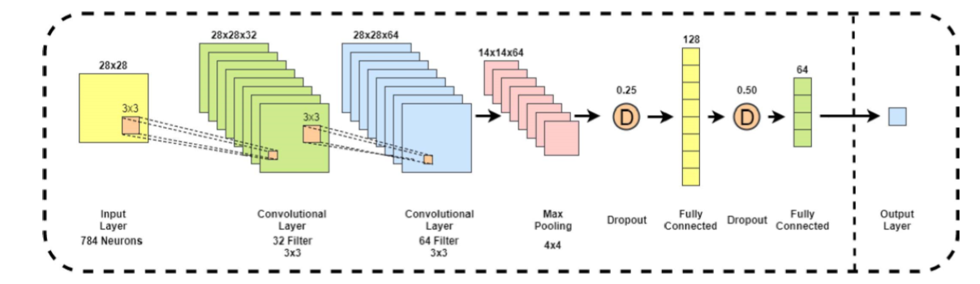
Layers of CNN

Slide 15
Layers of CNN
Input layer : In this layer, the dataset is retrieved and the graph is plotted based on this data.
These graphs are saved as images into the database.
Convolutional Layer: Applies filters on the image according to the requirement. As we know , image has lot of pixels in it. So each pixel is assigned some value and converted into matrix.
ReLU activation:
Allows the model to learn non-linear representations of the data.
Applied to every layer.
Its output is represented as f(x)=max(0,x).

Slide 16
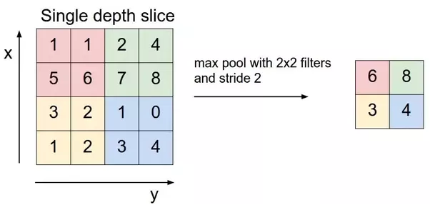
Layers of CNN
Max Pooling Layer : Reduces the no. of parameters when images are large. And reduces the dimensionality of matrix but retains the important information.
Dropout Layer : Drops the irrelevant data to store only important features required.

Slide 17
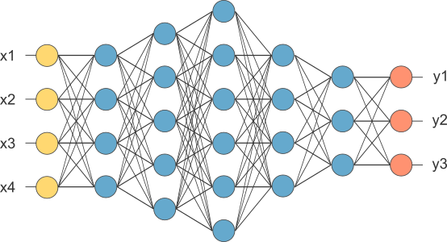
Layers of CNN
6. Fully Connected Layer : Creates a network to create the model.
First, matrix is converted into the vectors and these vectors are passed to create a network.

Slide 18
Workflow of CNN in Stock Market Prediction
Retrieve data from Google Finance, Yahoo Finance , etc.
Generate graph using matplotlib library in python
Convert images to thumbnails using HDFS library
Create network using features obtained (using keras library)
Train the model
Output

Slide 19
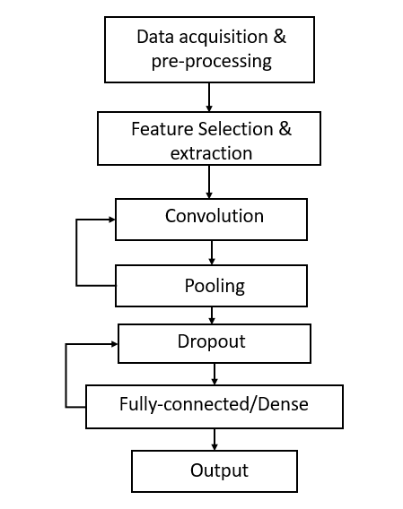
Architecture 0f CNN –

Slide 20
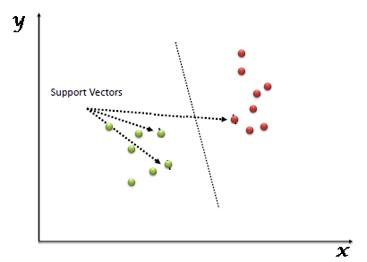
SVM
“Support Vector Machine” (SVM) is a supervised machine learning algorithm which can be used for both classification or regression challenges.
we perform classification by finding the hyper-plane that differentiate the two classes very well.

Slide 21
SVM Classification in Stock Market :
The use of SVM classification in stock prediction basically refers to classifying the stocks as a good investment or a bad investment. We use four company-specific variables (net revenue, net income, price per earnings ratio of stock, diluted earnings per share) and label each stock in a specific year in our data set as a good or a poor investment. Although there is no definitive method for defining a market investment as “good” or “poor”, we use a method that is simple and objective: if the price of a company’s stock over a given year rose, it is classified as a good investment, otherwise it is classified as a poor investment.

Slide 22
PSO
Particle swarm optimization (PSO) is a population based stochastic optimization. Optimization is achieved by giving each individual in the search space a memory for its previous successes, information about successes of a social group and providing a way to incorporate this knowledge into the movement of the individual. Therefore, each individual (called particle) is characterized by its position, its velocity v, its personal best position and its neighbourhood best position. The velocities and variable vector are updated and process is repeated till a satisfactory solution is found.
.

Slide 23
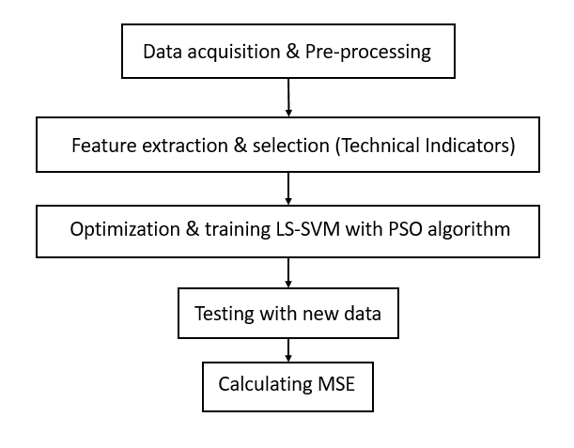
The proposed model using SVM-PSO:

Slide 24
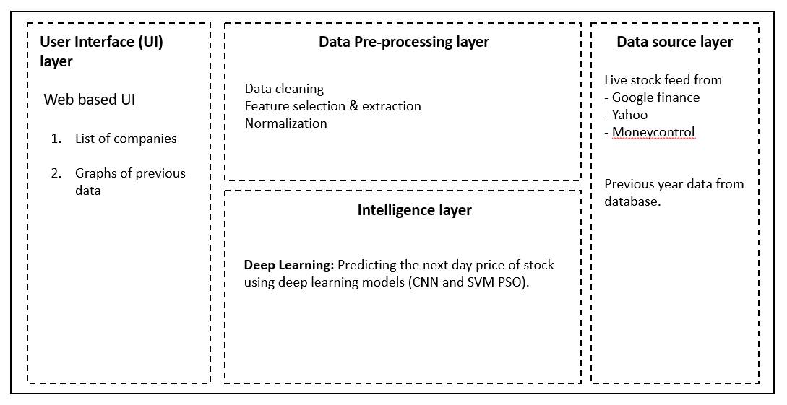
System Architecture

Slide 25
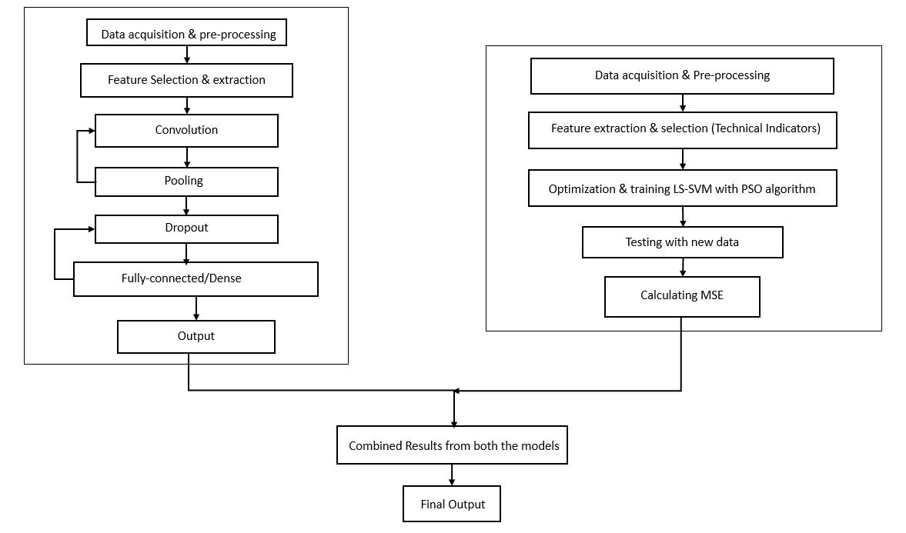
System Architecture –

Slide 26
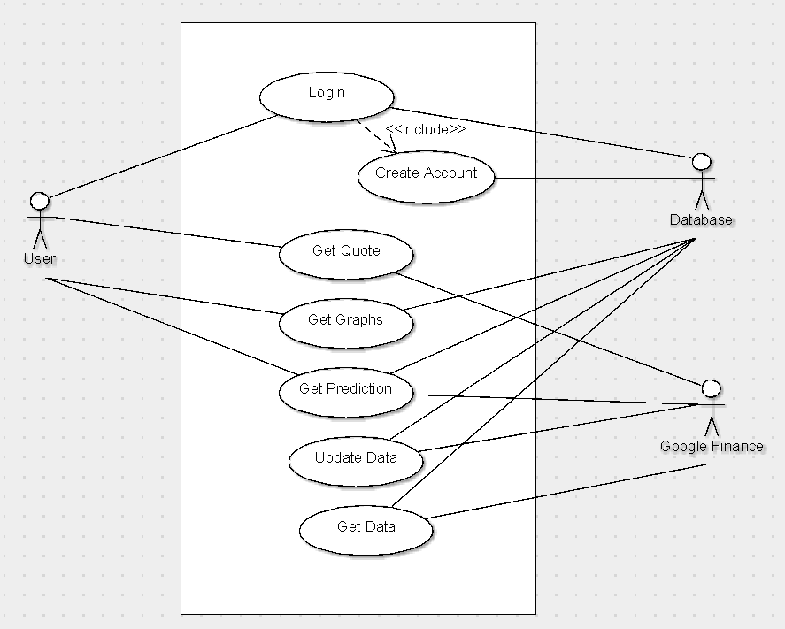
UML Diagrams – Use case

Slide 27
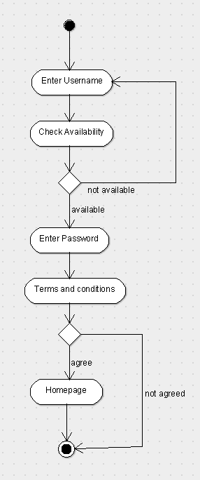
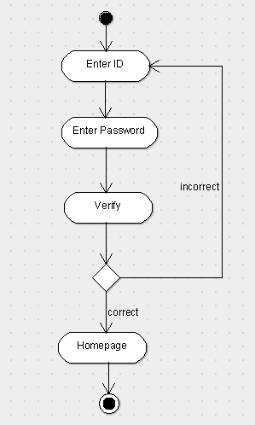
UML Diagrams - Activity
Register
Login Activity

Slide 28
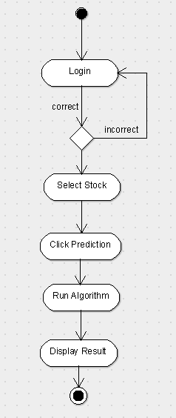
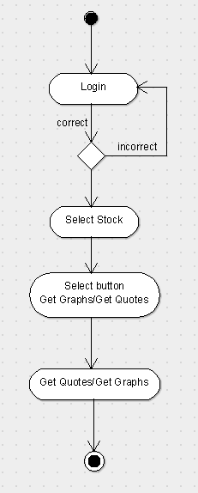
UML Diagrams - Activity
Get Prediction
Get Quotes

Slide 29
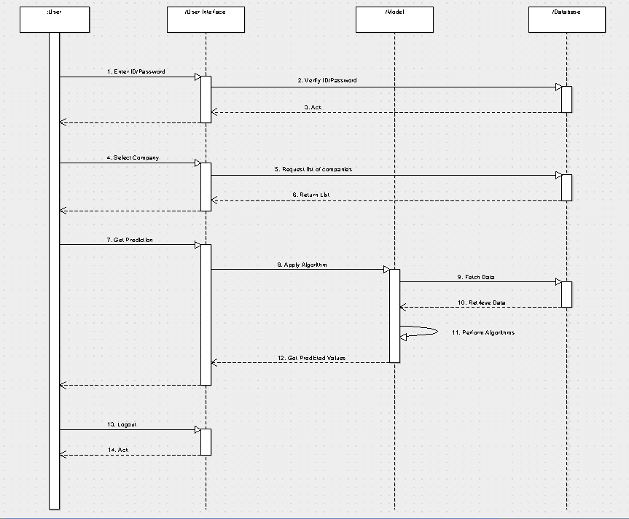
UML Diagrams - Sequence

Slide 30
Software Tools / Technologies
Technology/Tool | Platform | Use
HTML,CSS, Javascript | Windows | Web UI Development
XAMPP(MYSQL) | Windows | Backend Database
Python 3.0 | Windows | To run ML algorithms
Keras | Windows | For Deep Learning Algorithms
Matplotlib | Windows | To visualize the data properly

Slide 31
Hardware Requirements
Name | Use
PC/Laptop/mobile | To use the web based system
Other Requirements
An active Internet Connection

Slide 32
Outcomes
A efficient system for stock market prediction is developed.
A friendly Graphical User Interface for customers.
Better idea of varying stock prices using graphs.
Automated system; running scripts in timely manner to fetch real time data.

Slide 33
References
[1] Sreelekshmy Selvin, Vinayakumar R, Gopalakrishnan E.A, Vijay Krishna Menon, ‘STOCK PRICE PREDICTION USING LSTM,RNN AND CNN-SLIDING WINDOW MODEL’, International Conference on Advances in Computing, Communications and Informatics (ICACCI),IEEE, Udupi, India, Sept 2017
[2] Luca Di Persio , Oleksandr Honchar ‘Artiﬁcial Neural Networks architectures for stock price prediction: comparisons and applications , 2016
[3] Avraam Tsantekidis, Nikolaos Passalis, Anastasios Tefas, Juho Kanniainen, Moncef Gabbouj and Alexandros Iosiﬁdis ‘Forecasting Stock Prices from the Limit Order Book using Convolutional Neural Networks’

Slide 34
References
[4] Anastasia Borovykh Sander,Bohte, Cornelis W. Oosterle ‘Conditional time series forecasting
with convolutional neural networks’ June 2018
[5] Trevor M. Sands, Deep Tayal, Matthew E. Morris, and Sildomar T. Monteiro,’ Robust Stock Value Prediction using Support Vector Machines with Particle Swarm Optimization’, 2015 IEEE Congress on Evolutionary Computation (CEC) , IEEE, Sendai, Japan, May 2015
[6] Osman Hegazy, Omar S. Soliman and Mustafa Abdul Salam, ‘A Machine Learning Model for Stock Market Prediction’ , International Journal of Computer Science and Telecommunications , Egypt, December 2013

Slide 35
References
[7] M. Karazmodeh, S. Nasiri, and S. Majid Hashemi, ‘Stock Price Forecasting using Support Vector Machines and Improved Particle Swarm Optimization’, Journal of Automation and Control Engineering, North Cyprus, Turkey, June ,2013
[8] http://faganasset.com/2015/04/16/if-not-the-stock-market-then-where/
[9] cs231n.github.io/convolutional-networks/
[10] deeplearning4j.org
[11]https://en.wikipedia.org/wiki/Stock_market

Slide 36


